Slide 1
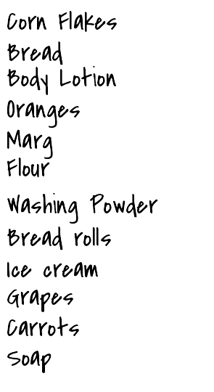

Slide 2
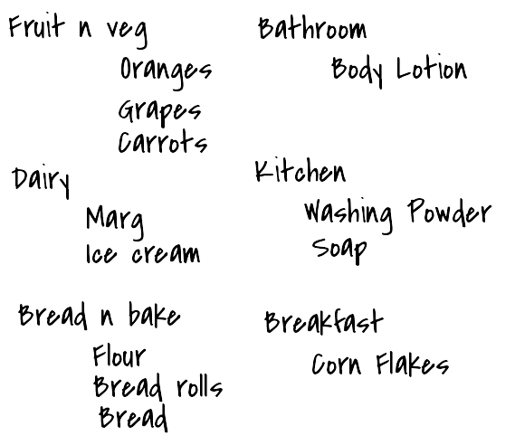

Slide 3
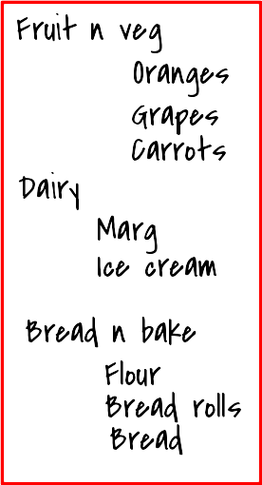
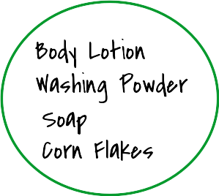

Slide 4
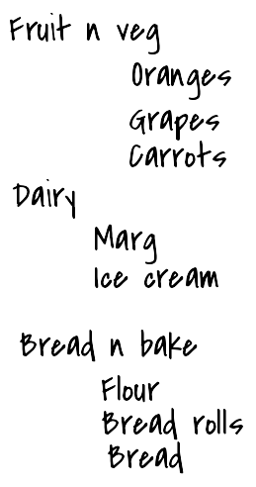
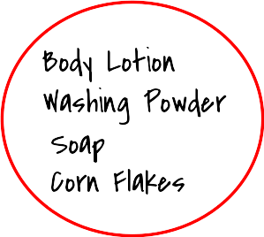
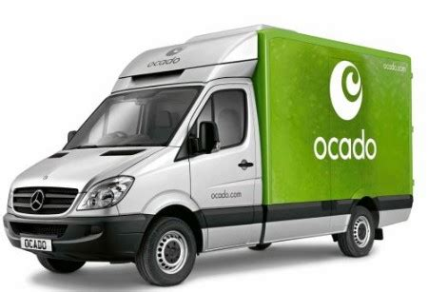

Slide 5

Interpreter
Compiler
Just-in-time compilation
WebAssembly

Slide 6
Fruit n veg
Oranges
Body Lotion
Grapes
Washing Powder
Carrots
Soap
Dairy
Corn Flakes
Marg
Ice cream
Bread n bake
Flour
Bread rolls
Bread

Slide 7
WebAssembly
(also known as)
Wasam

Slide 8

What is WebAssembly ?
Why is it important?
Where is it used?

Slide 9
What is WebAssembly ?

Slide 10
Why is it important?

Slide 11



Where is it used used?

Slide 12

Where is it used used?

Slide 13

Where is it used used?
“WebAssembly cut Figma's load time by 3x”

Slide 14
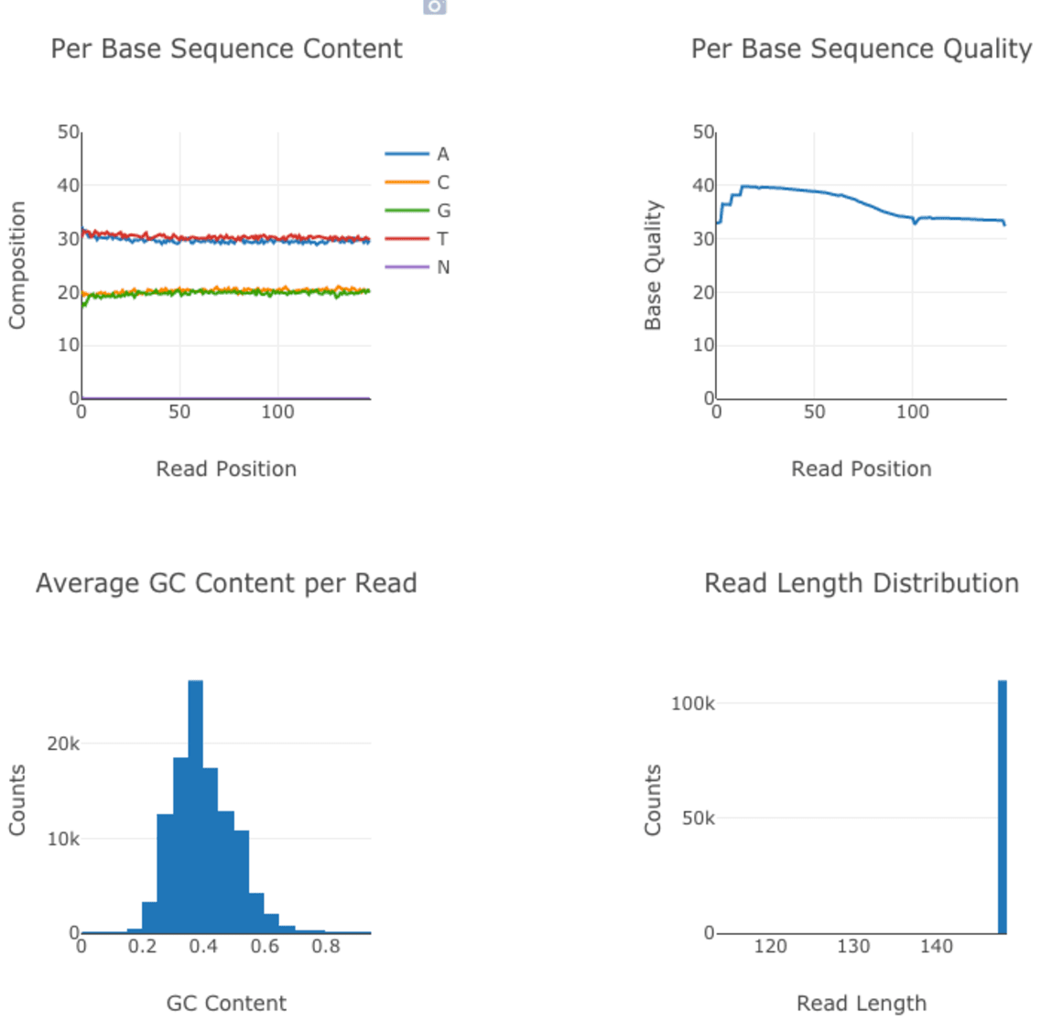
Where is it used used?
How We Used WebAssembly To Speed Up Our Web App By 20X (Case Study)
fastq.bio provides scientists with a quick preview of the quality of their DNA sequencing data

Slide 15

Where is it used used?
Pyodide
...we’re meeting data scientists where they are by bringing the popular and mature Python scientific stack to the browser.

Slide 16
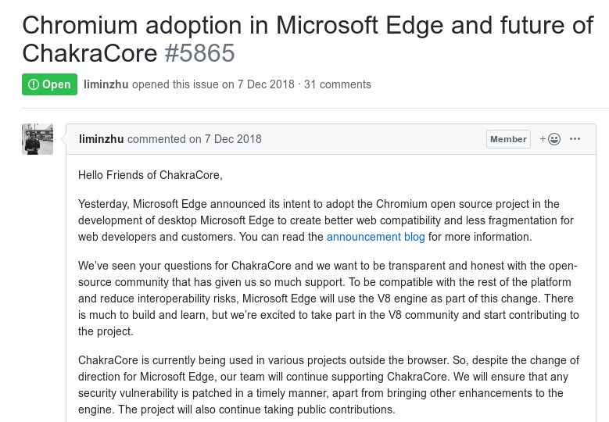
future impact?

Slide 17


What is WebAssembly ?
Why is it important?
Where is it used?
Future impact?

Slide 18


